Slide 1
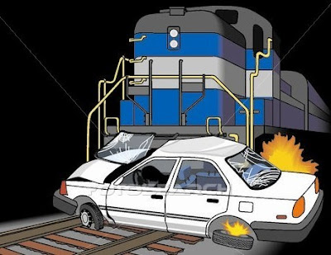
US Highway RailRoad Crossing Accident
DATS 6103 PROJECT
Team 3 Members:
Aakash Hariharan
Abhilasha Singh
Trisha Singh
Vishal Fulsundar

Slide 2
Overview
Purpose
Smart questions
Data Overview
Exploratory Data Analysis
Addressing SMART Questions Using Data Visualizations and Predictive Models
Conclusion

Slide 3
Purpose
Summarize important background research and EDA
Answer the SMART questions by building plots & models

Slide 4

Smart Questions

Slide 5

Dataset Details
US Highway Railroad Crossing Accident dataset sourced from Kaggle
Dataset contains,
120365 observations
46 variables
Railroad Information, Incident Details, Location Information, Highway and Crossing Details, Vehicle Information, Train Information, Environmental Conditions

Slide 6
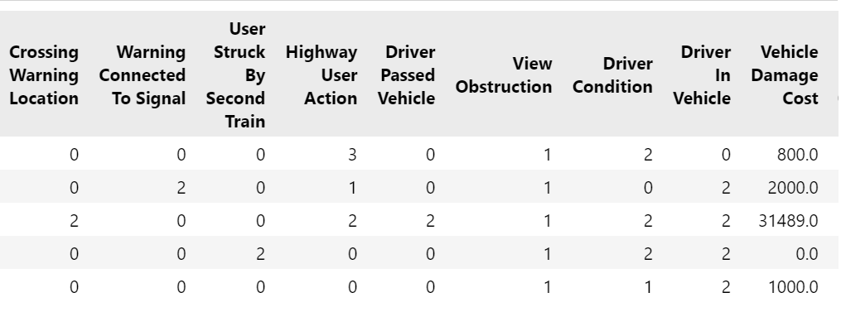
Preprocessing Overview
No missing values
Drop Duplicate rows
View unique values
Data Type Conversion
Outliers

Slide 7
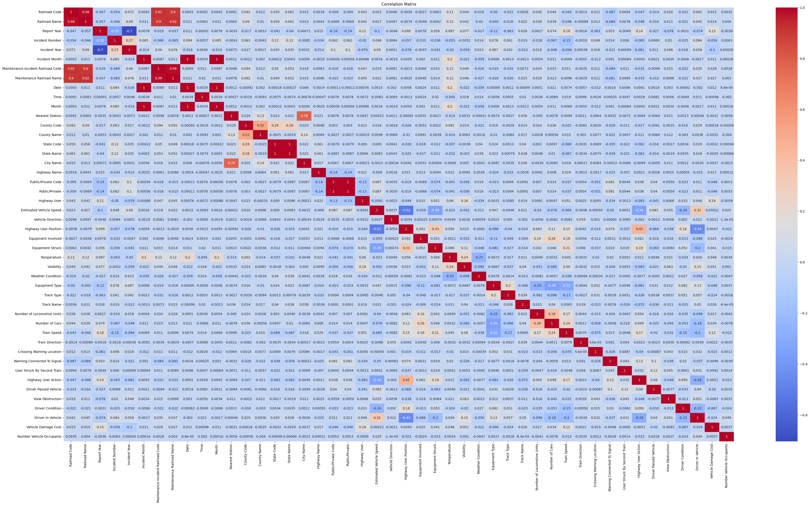
Data Visualization Exploration
Correlation Matrix
Insights:

Slide 8
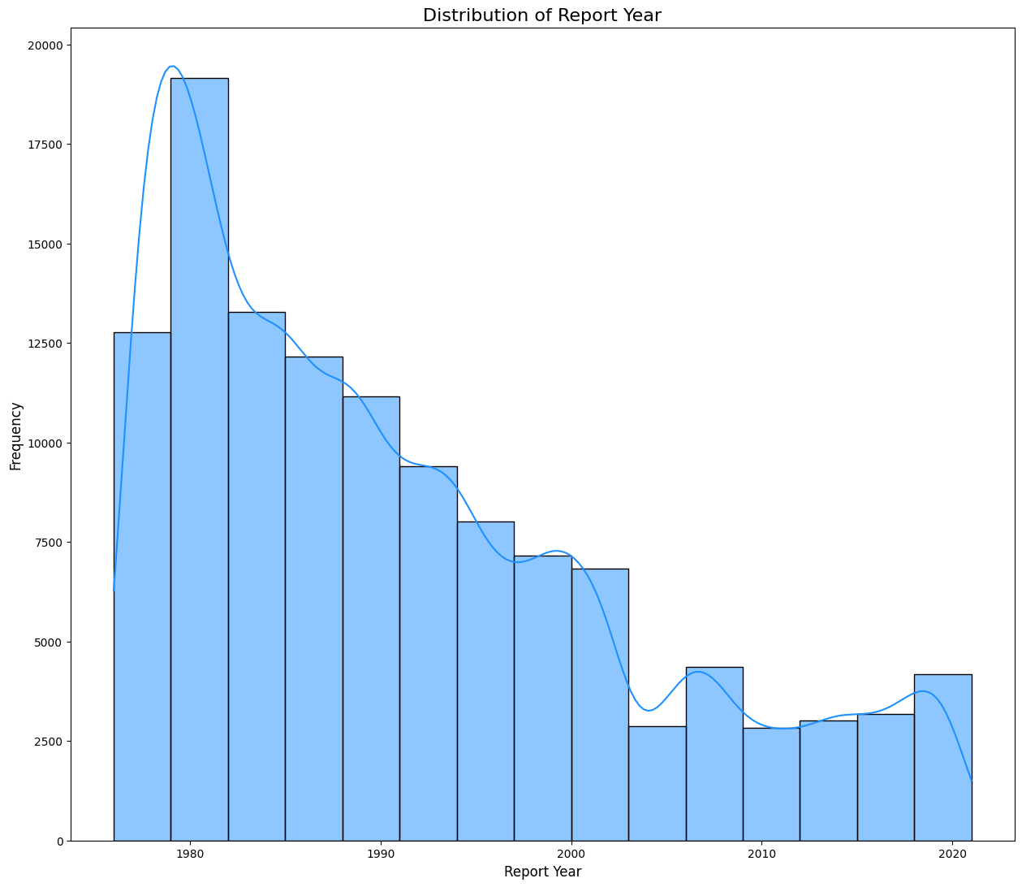
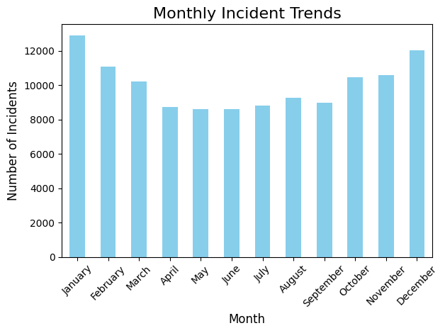
Data Visualization Exploration
In 1980, the incident count was significantly higher, but over the years, there has been a sharp decline in the number of incidents.
January and December show the highest number of incidents, while April, May, and June experience a significant drop of around 3,000 incidents.

Slide 9
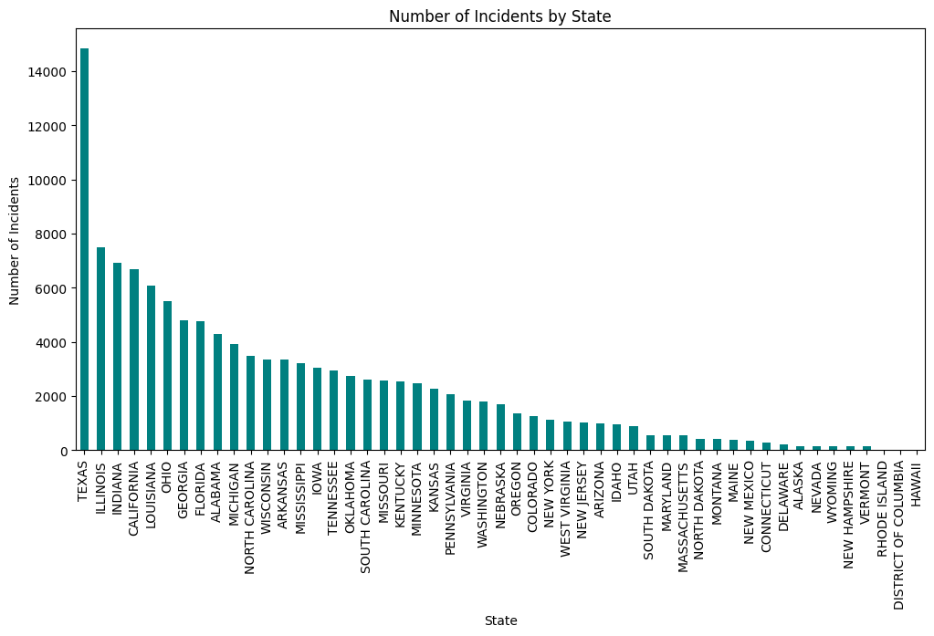
Data Visualization Exploration
Texas has the significantly highest number of incidents, followed by Illinois, Indiana. In contrast, Hawaii and District of Columbia has almost no incidents.

Slide 10
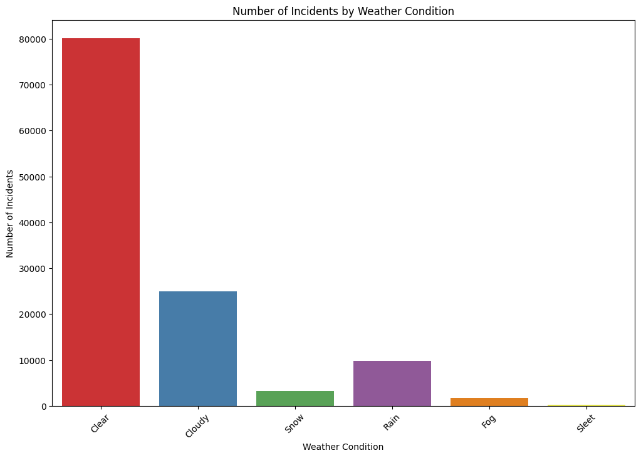
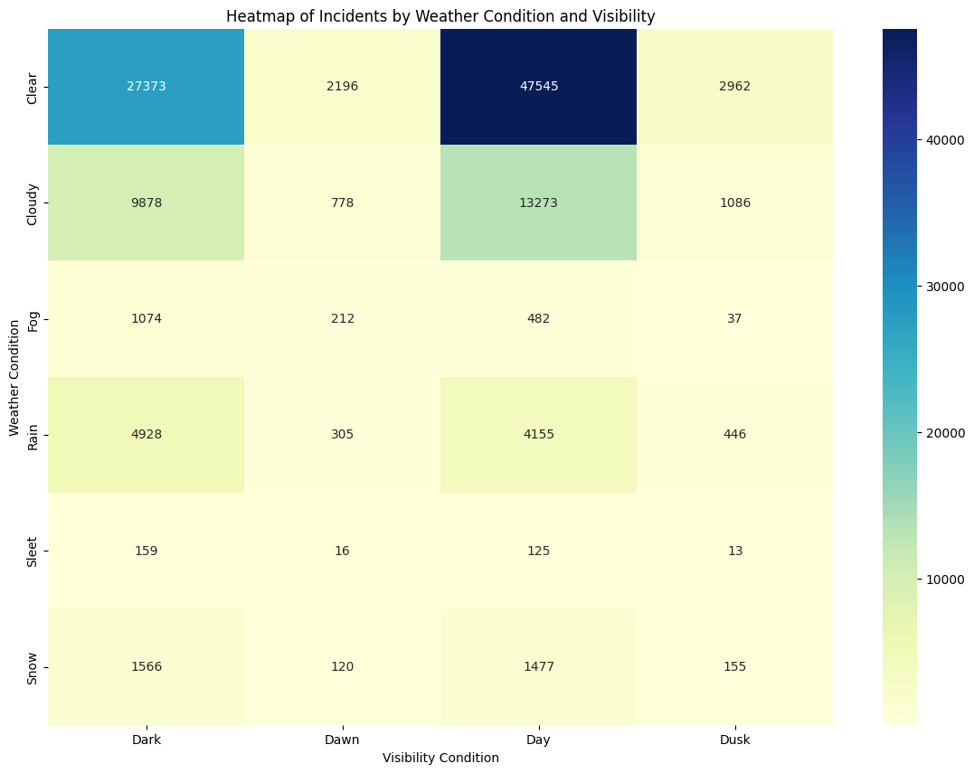
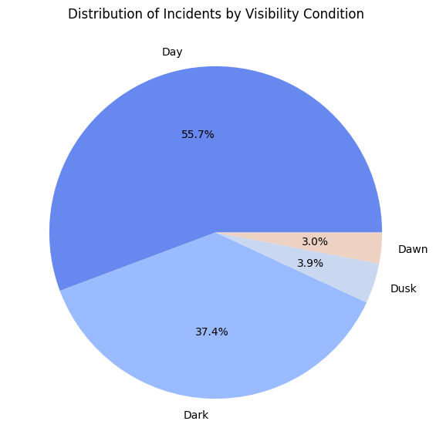
Data Visualization Exploration
Clear weather is linked to a significant number of incidents. Additionally, when examining the visibility graph, we observe that 50% of incidents occur during daylight hours, followed by 38% during nighttime.
The highest number of incidents occur during daylight hours with clear skies.

Slide 11
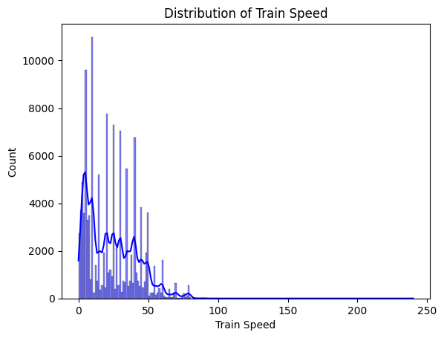
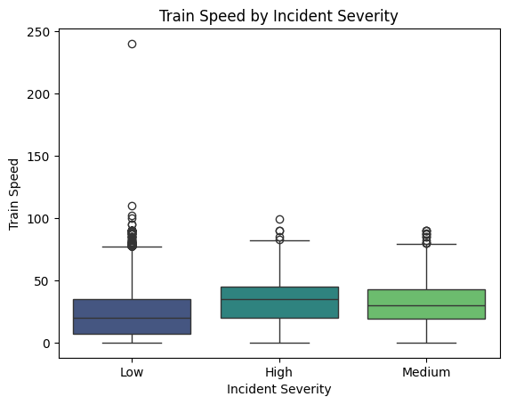
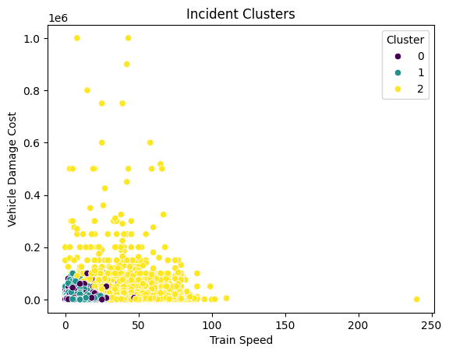
Data Visualization Exploration
Trains with speeds less than 50 have the highest incident count.
No significant difference between severity and train speed, but a slight increase in severity can be observed with higher speeds.
Texas has the significantly

Slide 12
Conclusion

Slide 13

Any thoughts or questions?

